Slide 1
FEATURE SELECTION IN MACHINE LEARNING.
GROUP 5

Slide 2
WHAT IS FEATURE SELECTION?.
Feature selection is the process of choosing a subset of relevant features (or variables) from a larger set of available features in a dataset. The goal is to reduce the dimensionality of the dataset by eliminating irrelevant, redundant, or noisy features, which can improve the performance of machine learning models and reduce overfitting.
Feature selection helps in:
Improving model performance: By removing irrelevant or less important features, the model can focus on the most impactful ones.
Reducing computational cost: A smaller dataset means faster training and prediction times.
Avoiding overfitting: Fewer features reduce the chance that the model will learn patterns that do not generalize well to new data.

Slide 3
TYPES OF FEATURE SELECTION
1.DOMAIN KNOWLEDGE
Domain knowledge refers to expert understanding of the problem, industry, or dataset being analyzed..
It helps in selecting, engineering, and interpreting features that truly impact the outcome rather than relying solely on automated techniques.
For example:
In manufacturing, an engineer knows that machine vibration patterns can indicate faults before failure.
Without domain knowledge, a model may select irrelevant or misleading features, reducing its effectiveness.

Slide 4
TYPES OF FEATURE SELECTION.
2.FILTER METHODS
Filter Methods are feature selection techniques that evaluate each feature independently based on its statistical properties to determine its relevance to the target variable. These methods rely on measures that assess the relationship between features and the target, such as correlation or statistical tests, rather than using machine learning models.
Carried out as preprocessing step before even running a model. Works by observing characteristics of how variables are related to one another.
Depending on the model used, different metrics are used to determine which features will be dropped and which will be used.They will return a ‘feature ranking’ that will tell you how features are ordered in relation to another.

Slide 5
Filter Methods
Types of filter methods.
1.Information Theoretic Methods: Mutual Information measures how much information a feature shares with the target, while Entropy measures the uncertainty or disorder of a feature.
2.Variance Thresholding: This method removes features with low variance (little variation), as they are unlikely to be informative.

Slide 6
2. WRAPPER METHODS.
Wrapper Methods in machine learning evaluate feature subsets by training and assessing the performance of a model using different combinations of features. These methods are more computationally expensive but can find the optimal set of features for the model by directly considering their impact on model performance.
.Types of wrapper methods.
1.Recursive Feature Elimination (RFE): Iteratively removes the least important features based on model performance until the optimal feature subset is found.
2.Forward Selection: Starts with no features, adding one feature at a time that improves model performance until no improvement is observed.
3.Backward Elimination: Starts with all features and removes the least significant feature at each iteration based on model performance

Slide 7
3. Embedded methods.
Embedded methods perform feature selection during the model training process. These methods evaluate feature importance as part of the model building and automatically select the most relevant features based on the model's learning.
Examples:
Lasso (L1 Regularization): Penalizes the absolute value of coefficients, forcing some feature coefficients to zero, effectively selecting only the most important features.
Decision Trees: Use criteria like Gini impurity or information gain to evaluate feature importance and select the best features for splitting.
Random Forests: An ensemble of decision trees that calculates feature importance based on how frequently features are used in decision splits.
Gradient Boosting: Builds models sequentially, evaluating feature importance at each step based on how well features improve model predictions.

Slide 8
Benefits of Feature Selection in Machine Learning:
Improved Model Performance: Focuses on important features, boosting accuracy and generalization.
Reduced Overfitting: Lowers the risk by removing irrelevant features.
Faster Training and Prediction: Fewer features mean quicker processing times.
Lower Computational Costs: Reduces resource usage for large datasets.
Better Interpretability: Simpler models are easier to explain.
Enhanced Generalization: Helps the model perform better on unseen data.

Slide 9
BIAS-VARIANCE TRADEOFF.

Slide 10
What is bias- variance tradeoff?
The bias-variance tradeoff refers to the balance between two types of errors:
Bias: Error from overly simple models that underfit the data, leading to poor performance.
Variance: Error from complex models that overfit the data, learning noise instead of general patterns.
Tradeoff:
Increasing model complexity reduces bias but increases variance.
The ideal model minimizes both to achieve better generalization and performance on new data.

Slide 11
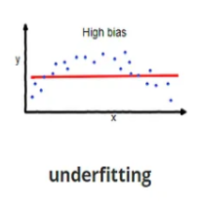
High bias (underfitting).
Characteristics of Underfitting:
Simplistic Model: Too simple to capture underlying patterns.
High Bias: Makes strong assumptions leading to systematic errors.
Low Complexity: The model is too basic (e.g., using linear regression for a nonlinear problem).
Poor Training Performance: Fails to fit the training data well.
Effects of Underfitting:
Low Accuracy: Poor performance on both training and test data.
Missed Patterns: Fails to capture important data patterns.
Underutilized Data: Does not learn enough from the dataset.

Slide 12
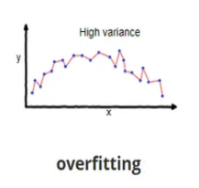
High variance (overfitting).
Characteristics of Overfitting:
High Model Complexity: The model learns too many details, including noise.
Low Bias, High Variance: Fits training data perfectly but struggles with new data.
Poor Generalization: Performs well on training data but poorly on test data.
High Sensitivity to Data: Small changes in training data can drastically change predictions.
Effects of Underfitting:
Poor Accuracy: Low performance on both training and test data.
Missed Patterns: Fails to capture important trends in the data.
Poor Generalization: The model cannot make accurate predictions on new data.
High Bias: The model makes overly simplistic assumptions, leading to systematic errors.

Slide 13
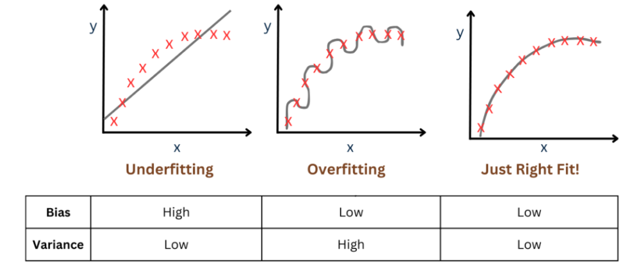
Graphs illustrating overfitting and underfitting.

Slide 14
Techniques to handle bias-variance tradeoff.
Cross-Validation: Estimates model performance on unseen data to avoid underfitting and overfitting.
Regularization: L1 (Lasso) or L2 (Ridge) penalize large coefficients, reducing overfitting.
Model Complexity Adjustment:
For High Bias and low variance: low complexity(underfit)
For low Bias and High Variance: high complexity(overfit).
Ensemble Methods:
Bagging reduces variance (e.g., Random Forest).
Boosting reduces bias (e.g., Gradient Boosting).
Data Augmentation: Adds more data to reduce variance.
Early Stopping: Stops training early to prevent overfitting.

Slide 15
QUESTIONS?!
Thank you.

